Slide 1
Logistic Regression

Slide 2
Introduction
Logistic regression extends the ideas of linear regression to the situation where the dependent variable, Y , is categorical.
A categorical variable as divides the observations into classes.
  If Y denotes a recommendation on holding /selling / buying a stock, then we have a categorical variable with 3 categories.
  Each of the stocks in the dataset (the observations) as belonging to one of three classes: the “hold" class, the “sell" class, and the “buy” class.
Logistic regression can be used for classifying a new observation into one of the classes, based on the values of its predictor variables (called “classification").
It can also be used in data (where the class is known) to find similarities between observations within each class in terms of the predictor variables (called “profiling").
[1]

Slide 3
Introduction
Logistic regression is used in applications such as:
  1. Classifying customers as returning or non-returning (classification)
  2. Finding factors that differentiate between male and female top executives (profiling)
  3. Predicting the approval or disapproval of a loan based on information such as credit scores (classification).
Here, we focus on the use of logistic regression for classification.
We deal only with a binary dependent variable, having two possible classes.
The results can be extended to the case where Y assumes more than two possible outcomes.
Popular examples of binary response outcomes are
  success/failure,
  yes/no,
  buy/don't buy,
  default/don't default, and
  survive/die.
We code the values of a binary response Y as 0 and 1.
[1]

Slide 4
Introduction
We may choose to convert continuous data or data with multiple outcomes into binary data for purposes of simplification, reflecting the fact that decision-making may be binary
  approve the loan / don't approve,
  make an offer/ don't make an offer)
Like MLR, the independent variables X₁,X₂, …,X_{k} may be categorical or continuous variables or a mixture of these two types.
In MLR the aim is to predict the value of the continuous Y for a new observation
In Logistic Regression the goal is to predict which class a new observation will belong to, or simply to classify the observation into one of the classes.
In the stock example, we would want to classify a new stock into one of the three recommendation classes: sell, hold, or buy.
[1]

Slide 5
Logistic Regression
In logistic regression we take two steps:
  the first step yields estimates of the probabilities of belonging to each class.
In the binary case we get an estimate of P(Y = 1),
  the probability of belonging to class 1 (which also tells us the probability of belonging to class 0).
In the next step we use
  a cutoff value on these probabilities in order to classify each case to one of the classes.
  In a binary case, a cutoff of 0.5 means that cases with an estimated probability of P(Y = 1) > 0.5 are classified as belonging to class 1,
  whereas cases with P(Y = 1) < 0.5 are classified as belonging to class 0.
  The cutoff need not be set at 0.5.
[1]

Slide 6
Logistic Regression
Unlike ordinary linear regression, logistic regression does not assume that the relationship between the independent variables and the dependent variable is a linear one.
Nor does it assume that the dependent variable or the error terms are distributed normally.
[1]

Slide 7
Logistic Regression
The "odds" of an event is defined as the probability of the outcome event occurring divided by the probability of the event not occurring.
In general, the "odds ratio" is one set of odds divided by another.
[1]

Slide 8

The Difference Between "Probability" and "Odds"
The probability that an event will occur is the fraction of times you expect to see that event in many trials. Probabilities always range between 0 and 1.
The odds are defined as the probability that the event will occur divided by the probability that the event will not occur.
If the probability of an event occurring is Y, then the probability of the event not occurring is 1-Y.
(Example: If the probability of an event is 0.80 (80%), then the probability that the event will not occur is 1-0.80 = 0.20, or 20%.
The odds of an event represent the ratio of the (probability that the event will occur) / (probability that the event will not occur). This could be expressed as follows:
Odds of event = Y / (1-Y)
So, in this example, if the probability of the event occurring = 0.80, then the odds are 0.80 / (1-0.80) = 0.80/0.20 = 4 (i.e., 4 to 1).
if a race horse runs 100 races and wins 25 times and loses the other 75 times, the probability of winning is 25/100 = 0.25 or 25%, but the odds of the horse winning are 25/75 = 0.333 or 1 win to 3 loses.
[2]

Slide 9
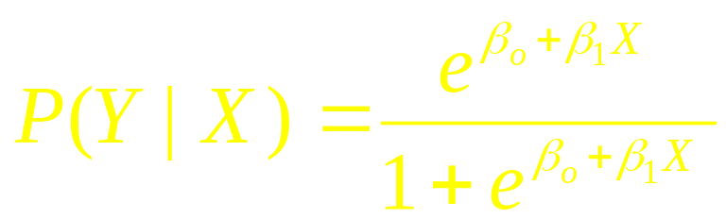
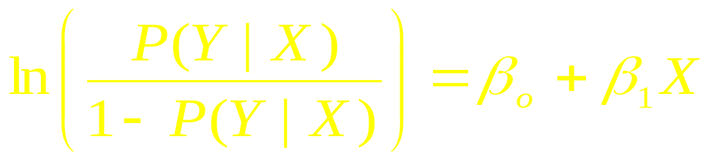
Logit Transformation
The logistic regression model is given by
which is equivalent to
This is called the
Logit Transformation

Slide 10
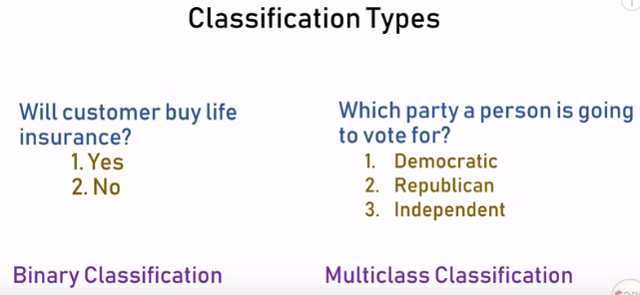
Logistic regression for classification problems
[3]

Slide 11
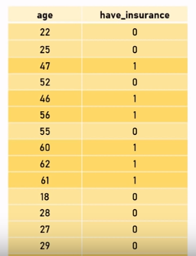
Example
Customers age and the insurance data. In this data, it can be likely observed that young people have less probability to buy an insurance
[3]

Slide 12
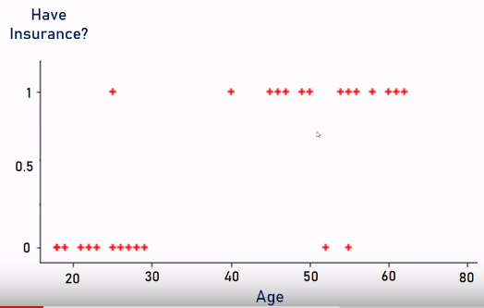
Scatter plot for data visualization
[3]

Slide 13
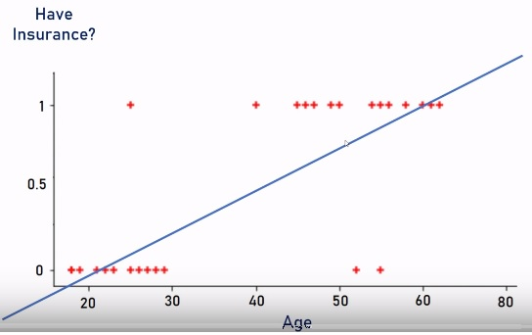
Scatter plot for data visualization
Is Linear regression suitable choice?
[3]

Slide 14
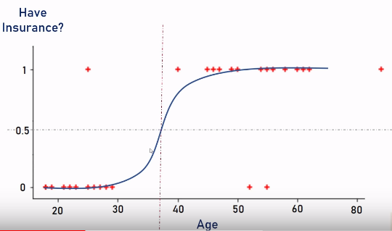
Sigmoid representation for logistic regression
[3]

Slide 15
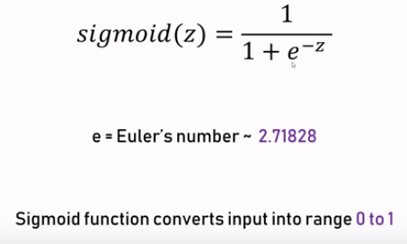
Sigmoid Function
[3]

Slide 16
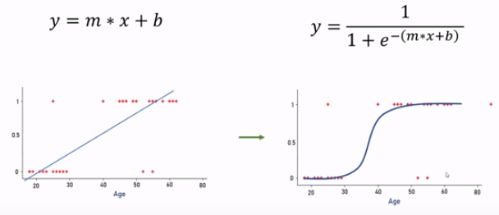
Linear versus Logistic
[3]

Slide 17
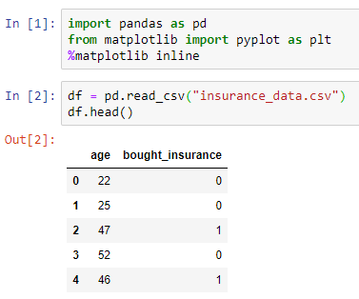
Implementation of example using Python
[3]

Slide 18
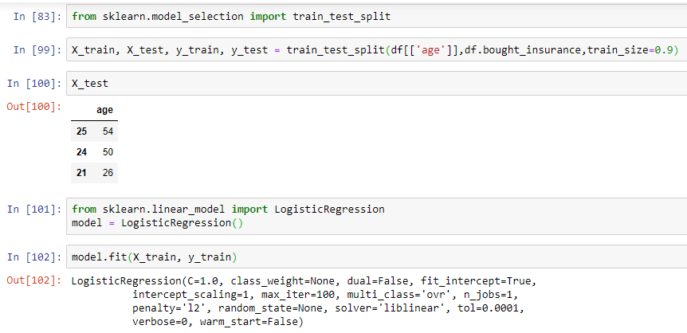
Implementation of example using Python
[3]

Slide 19
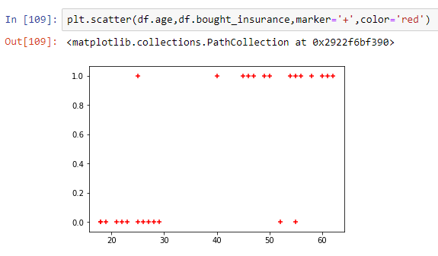
Implementation of example using Python
[3]

Slide 20
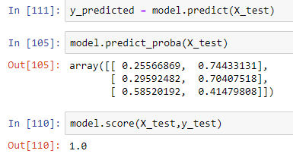
Implementation of example using Python
[3]

Slide 21
Implementation example using Python
import pandas as pd
df = pd.read_csv("insurance_data.csv")
from sklearn.model_selection import train_test_split
X_train, X_test, y_train, y_test = train_test_split(df[['age']],df.bought_insurance,train_size=0.9)
from sklearn.linear_model import LogisticRegression
model = LogisticRegression()
y_predicted = model.predict(X_test)
model.predict_proba(X_test)
model.score(X_test,y_test)
[3]

Slide 22
References
[1]. www.washburn.edu › faculty › boncella › XLMiner
[2]. http://sphweb.bumc.bu.edu/otlt/MPH-Modules/BS/BS704_Confidence_Intervals/BS704_Confidence_Intervals10.html
[3]. https://www.youtube.com/watch?v=J5bXOOmkopc

